Slide 1
INSTAGRAM USER ANALYTICS
PRINCE KUMAR
Email - prince22495@gmail.com

Slide 2
OUTLINE
Project Description
Approach
Tech-Stack Used
Insights
Result

Slide 3
PROJECT DESCRIPTION
The process of tracking how users engage and interact with our digital product (software or mobile application) in order to derive business insights for marketing, product, and development teams is known as user analysis.
Teams from across the company use these insights to decide what features to build for an app, launch a new marketing campaign, and more.
The product team of Instagram and the product manager has asked to provide insights on the questions asked by the management team.
The project’s focus is on marketing and investor metrics.

Slide 4
MARKETING AND INVESTOR METRICS
A). Marketing: The marketing team wants to launch some campaigns, and they need insights on
Rewarding Most Loyal Users
Remind Inactive Users to Start Posting
Declaring Contest Winner
Hashtag Researching
Launch AD Campaign
B). Investor Metrics: The investors want to know if Instagram is performing well and need metrics on
User Engagement
Bots & Fake Accounts

Slide 5
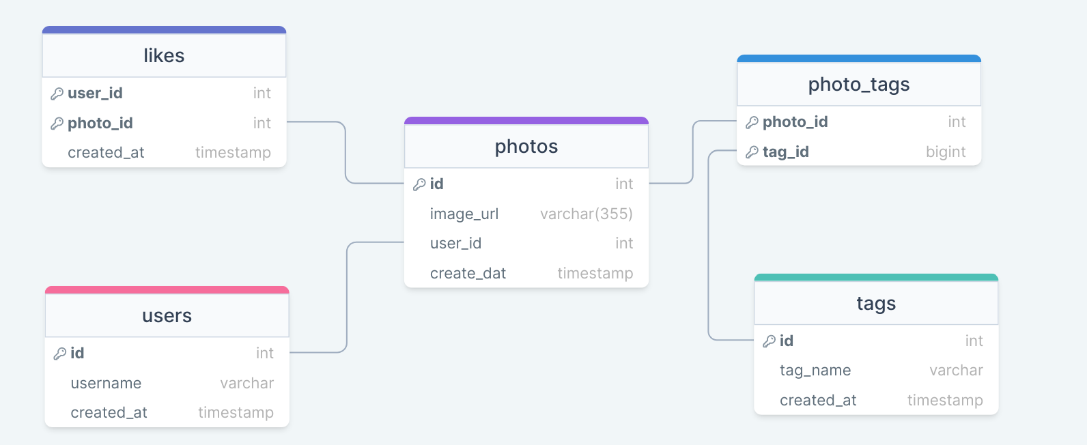
APPROACH
The database consists of 5 relational schemas as follows
SQL queries is used to analyze and derive insights from the data.

Slide 6

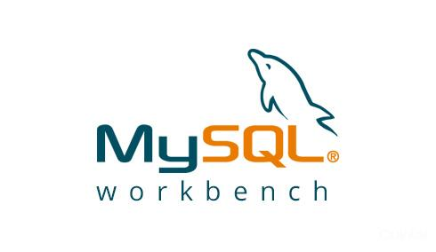
TECH-STACK USED
MySQL 8.0 is used to extract specific data and manipulate the data by using queries to find insights from the dataset.
MySQL Workbench 8.0 CE – To run queries

Slide 7
MARKETING INSIGHTS

Slide 8
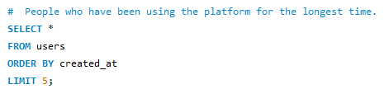
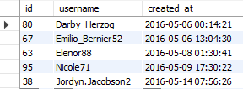
Most Loyal Users
People who have been using the platform for the longest time.
Task: Find the 5 oldest users of the Instagram from the database provided.
The 5 users who have been using the platform for the longest are: Darby, Emilio, Elenor, Nicole and Jordyn. (Thus, the most loyal users.)

Slide 9
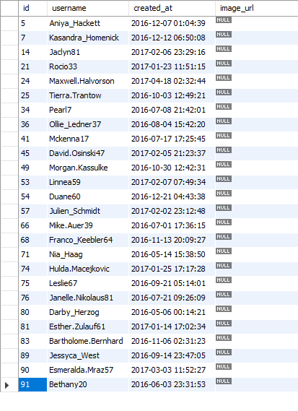
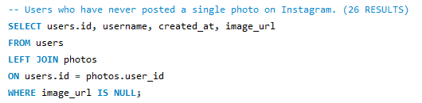
Inactive Users
Remind inactive users to start posting by sending them promotional emails to post their 1st photo.
Task: Find the users who have never posted a single photo on Instagram
26 inactive users out of 100 who didn’t post any photo.

Slide 10
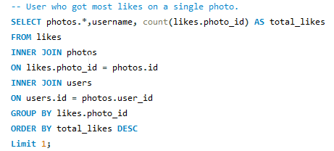
Contest Winner
The team started a contest and the user who gets the most likes on a single photo will win the contest now they wish to declare the winner.
Task: Identify the winner of the contest and provide their details to the team.
Zack_kemmer93 with user_id 52 is the winner.
He got most likes i.e. 48, on a single photo with photo_id 145.

Slide 11
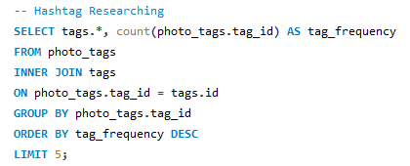
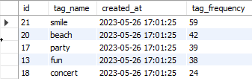
Hashtag Researching
A partner brand wants to know, which hashtags to use in the post to reach the most people on the platform.
Task: Identify and suggest the top 5 most commonly used hashtags on the platform.
Top 5 hashtags that the brand can use to reach maximum people are: #smile #beach #party #fun and #concert (in the descending order).

Slide 12
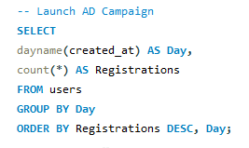
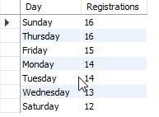
Launch AD Campaign
The team wants to know, which day would be the best day to launch Ads.
Task: What day of the week do most users register on? Provide insights on when to schedule an ad campaign.
As per the results, the most number of registrations (16) happen on Sunday and Thursday. Therefore, those days would be the best to launch Ads.

Slide 13
INVESTOR INSIGHTS

Slide 14
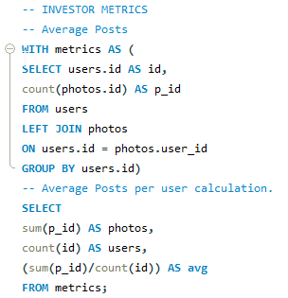

User Engagement
Are users still as active and post on Instagram or they are making fewer posts
Task: Provide how many times does average user posts on Instagram. Also, provide the total number of photos on Instagram/total number of users
Total Photos – 257 Total Users – 100 On an average, a user posts 2-3 photos daily.

Slide 15
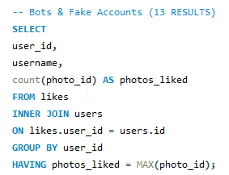
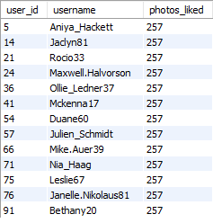
Bots & Fake Accounts
The investors want to know if the platform is crowded with fake and dummy accounts
Task: Provide data on users (bots) who have liked every single photo on the site (since any normal user would not be able to do this).
Total Number of photos – 257
13 fake accounts (bots) are found, as they liked every single photo on the site.

Slide 16
RESULTS
All the questions asked by the management team were answered on the basis of marketing and investor metrics.
Marketing Metrics Results:
The top 5 most loyal users were identified.
The 26 inactive users were identified and were marked for receiving promotional mails.
Zack_kemmer93 with user_id 52 is the contest winner with most likes.
Top 5 hashtags are identified to get maximum reach on the platform.
Sundays and Thursdays would be the recommended day for launching Ad campaign.
Investor Metrics Results:
On an average, a user posts 2-3 photos a day.
13 Fake accounts were identified as they liked all 257 photos.

Slide 17
File links:
Project link: Click Here.
SQL script file / Working file link: Click Here.

Slide 18
THANK YOU!

